Slide 1



microTPCs in SuperBEAST
Belle2 Inter Detector Meeting
Sep 1 2011
Sven E. Vahsen
University of Hawaii

Slide 2
Contents
Motivation for commissioning detector
  BEAST2 a.k.a. SuperBEAST (Browder)
Proposed U. Hawaii contribution
  microTPCs (& support structure)
Three Commissioning Scenarios
  How to incorporate TPCs in those?
Status and work needed

Slide 3
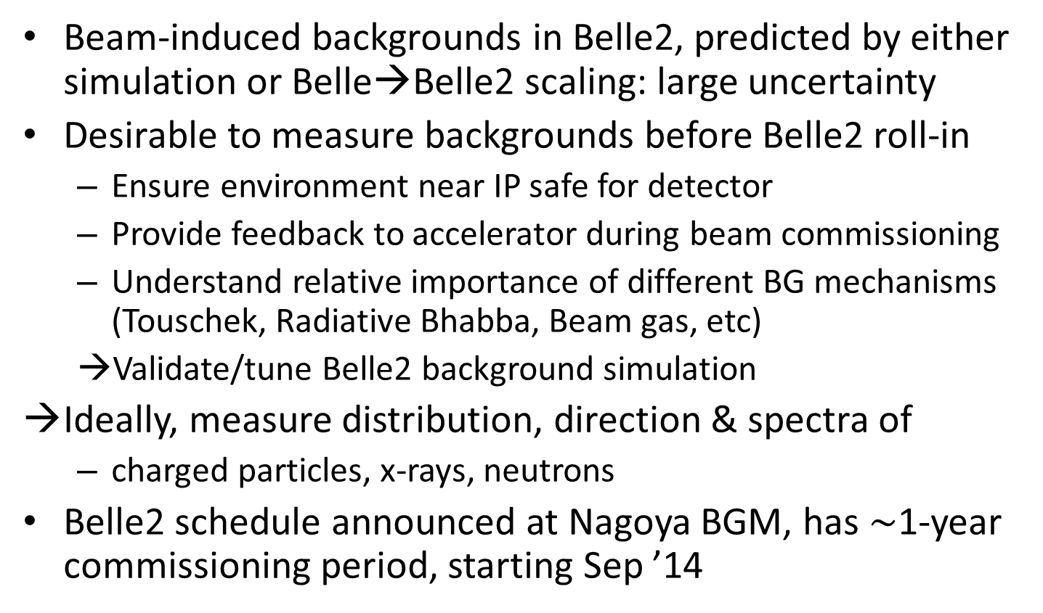
Motivation for Commissioning Detector
Beam-induced backgrounds in Belle2, predicted by either simulation or Belle→Belle2 scaling: large uncertainty
Desirable to measure backgrounds before Belle2 roll-in
  Ensure environment near IP safe for detector
  Provide feedback to accelerator during beam commissioning
  Understand relative importance of different BG mechanisms (Touschek, Radiative Bhabba, Beam gas, etc)
  →Validate/tune Belle2 background simulation
Ideally, measure distribution, direction & spectra of
  charged particles, x-rays, neutrons
Belle2 schedule announced at Nagoya BGM, has $\sim$1-year commissioning period, starting Sep ’14

Slide 4
U. Hawaii Proposal for BEASTII
BEASTII will definitely be a collaborative effort, requiring contributions from many groups (subdetector groups, DAQ, BG simulation, etc…)
University of Hawaii played leading role on BEAST, we’d like to contribute similarly to Beast II
  Design & build support structure
  Build micro-TPC detectors for detection of
    charged tracks
    neutrons (energy and direction)
    x-rays
    (more details in later slides)
  Help with Installation & Operation at KEK

Slide 5

More on the MicroTPCs
U. Hawaii & LBNL collaborating on Time Projection Chambers (TPC) with
  Gas Electron Multipliers
  ATLAS pixel electronics
  ATLAS pixel DAQ
Detection of charged tracks and x-rays demonstrated with 1cm³ prototype in 2007
Recently started work on larger, 2nd generation prototypes
  goal: demonstrate neutron detection this year
ionization
E
field cage
GEMs
pixel chip

Slide 6
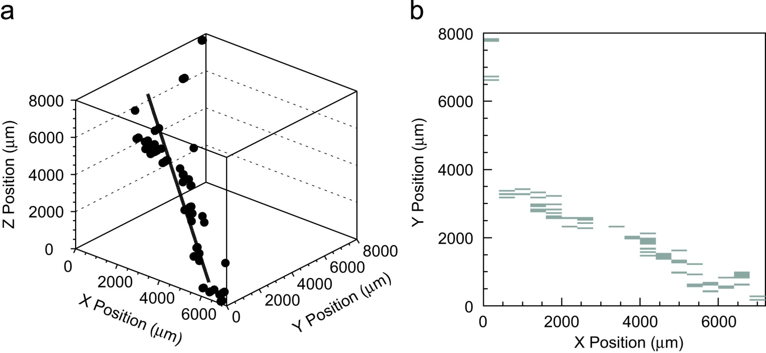

Detection of Charged Tracks
Large sample of cosmic rays
Require >10 pixel hits
3D track at least 4.5mm long
Gain=9000, threshold=1800e-
 | track fit residual | Diffusion | σ_{GEM+Pixel}
σ_{X} (μm) | 170 | 110 | 130
σ_{Y} (μm) | 130 | 110 | 70
σ_{Z} (μm) | 240 | 190 | 150
FE chip readout
(16x25=400ns)
3d track fit
Readout of TPC tracking chambers with GEMs and pixel chip. T. Kim, M. Freytsis, J. Button-Shafer, J. Kadyk, S.E. Vahsen, W.A. Wenzel (LBL, Berkeley) . 2008. 12pp. NIM (2008)
Excellent performance; single hit position resolution down to ~70 μm (limited by diffusion without magnetic field)

Slide 7
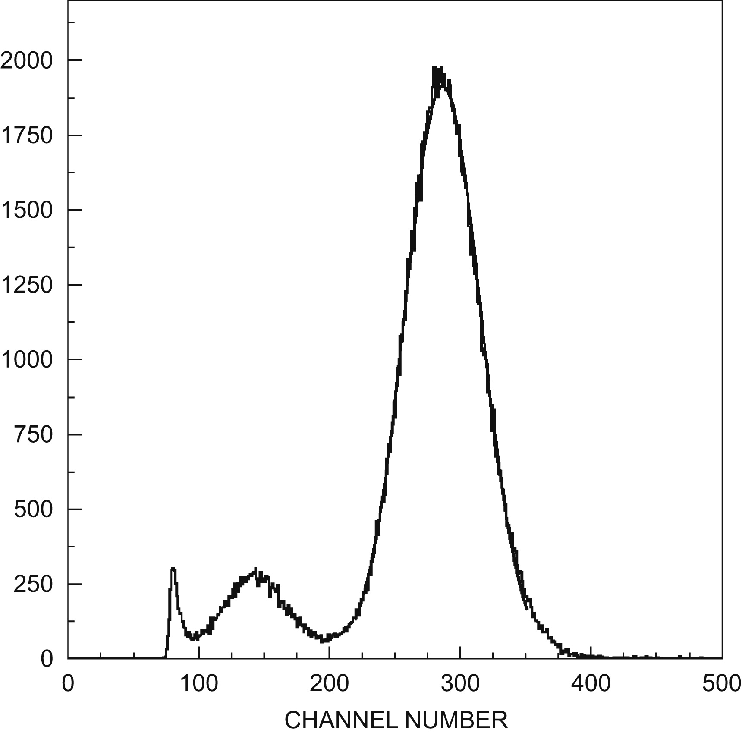
Detection of X-ray Lines
Electrons multiplied by avalanching in GEMs
Off-the shelf GEMs from CERN
  5cm x 5cm x 60 μm
  Hole spacing: 140 μm
Reliable without sparking with single-GEM gain up to 300 (Ar/C0₂)
Two GEMS in series: higher gain with less risk of sparking:
500V + 400V → gain = 40000
⁵⁵Fe (5.9keV X-rays)
500 V → multiplication factor 258
Copper
24%
FWHM
Kapton
Gain (uncalibrated)
x-ray lines are the "smoking guns" for SR backgrounds
Can measure x-ray spectrum in keV region with GEMs only (no pixels used)

Slide 8
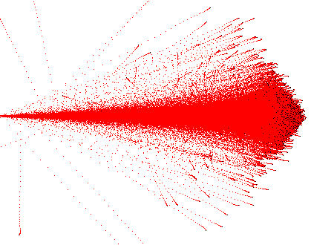
Detection of Neutrons
SRIM simulation
1-MeV Hydrogen nuclei recoiling in 1 atmosphere of C₄H₁₀ gas. 10⁵ recoils with identical start position and velocity have been superimposed
7.7mm
With suitable gas, can detect neutrons via nuclear recoils
  Large ionization signal (and we are sensitive even to single electrons)
  Large tracklength: 7.7mm at 1 atm, versus ~100 micron readout resolution
3D measurement of recoils → sensitive to energy and direction of neutrons
Distinguish neutrons from charged particles via dE/dX and length of tracks

Slide 9
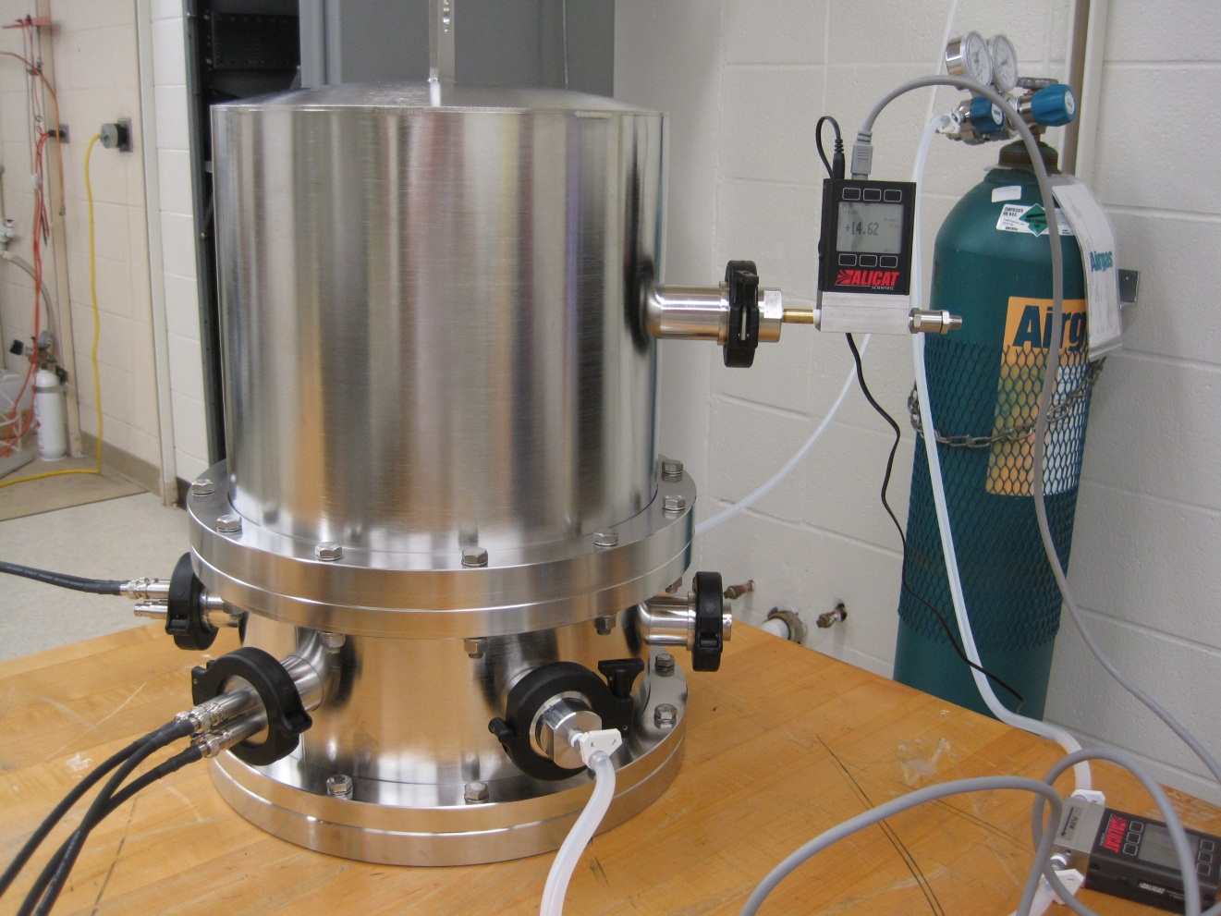
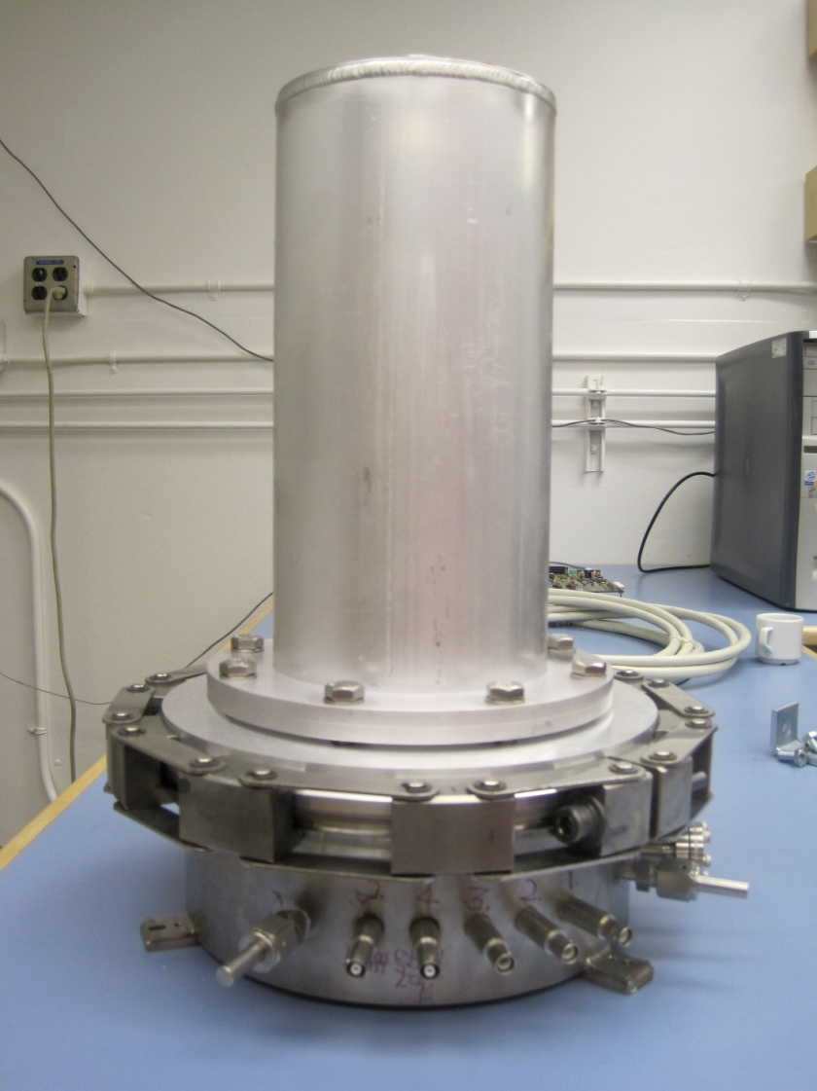
2nd Generation Prototypes Built
Berkeley
Hawaii
Working to demonstrate neutron detection this year at Hawaii. Currently commissioning Hawaii prototype and constructing collimated neutron source.
(note: vessels shown are much larger than what we are proposing for BEAST)

Slide 10

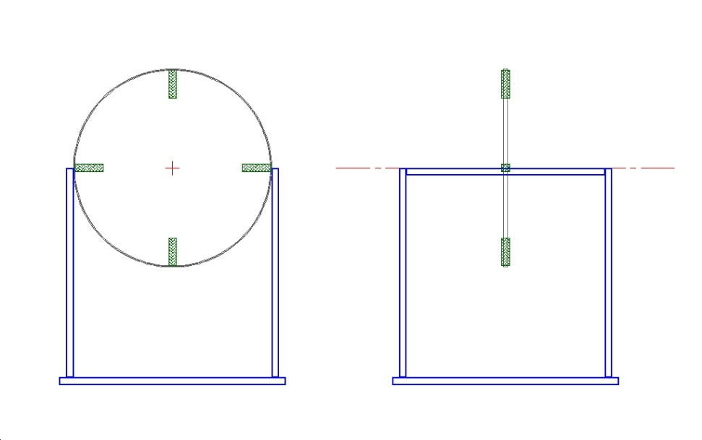
TPCs in BEASTII?
TPC w/ GEMs & Pixels may be a good match to commissioning needs - provides functionality that was missing in BEASTI
  detect and distinguish charged tracks, neutrons (energy and direction), x-rays
  point back to BG sources
With TPC, many geometries possible
  PEP2 used one large TPC
  I like the idea of a few “microTPCs” that can be moved around as needed
    Inexpensive and simple
    Larger radius → works at higher rates
    Nominally place at r~45 cm (similar to outer BEAST)
    Could make support structure moveable in z
    Can use existing ATLAS readout
microTPC geometry determined by
  Cross-section = Size of pixel chip, ~1x1cm or 2x2cm (ATLAS FE-I3 or FE-I4 pixel chip)
  Sufficient length to contain highest energy neutron recoils of interest: ~ 10 cm
PEP2 commissioning TPC
Four microTPCs, pointing towards IP
TPC drift field is radial
x/y view
z/y view

Slide 11
Three Scenarios
From Ushiroda San: How would TPCs fit into BEAST2?
Next pages gives some (very rough!) ideas → input for further discussion
Constraints
  prototype of sub-detectors such as PXD and SVD should be placed in the same location as the real detector.
  radiation monitors that will be installed in the real detector will be installed in the BEAST, too.
  Assume the beam pipe and masks attached to the
  beam pipe will be approximately the same as the final shape.
Three scenarios
  We roll-in the Belle solenoid + KLM and ECL without endcaps/TOP/CDC/SVD/PXD.
  BEAST components should be installed in the space for TOP/CDC/SVD/PXD.
  We roll-in the Belle solenoid with all the sub-detectors but SVD/PXD.
  BEAST components should be installed in the space for SVD/PXD.
  We don't roll-in Belle. BEAST has the largest free space to occupy.

Slide 12
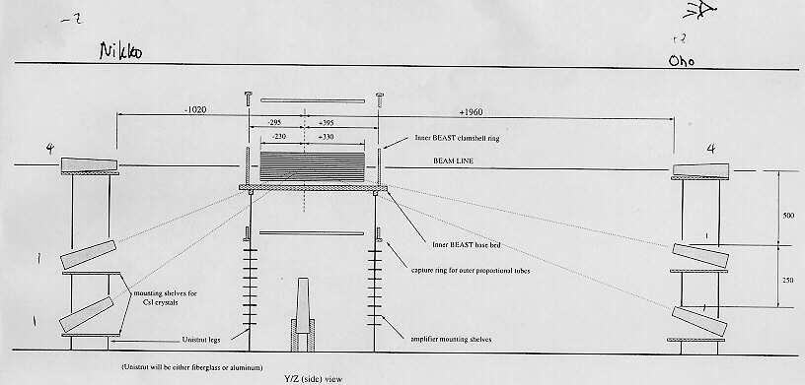
Scenario C
Don't roll-in Belle2. BEAST has the largest free space to occupy.
What we did for Belle1 → Can reuse basic design concept and ingredient of BEAST1, adjusting as needed
  Inner + outer layers of straw tubes, Crystals, Diodes, SVD ladder(s)
New elements for BEAST2
  Pixel ladder(s)
  Micro TPCs at r~50 cm
Side View of BEAST

Slide 13
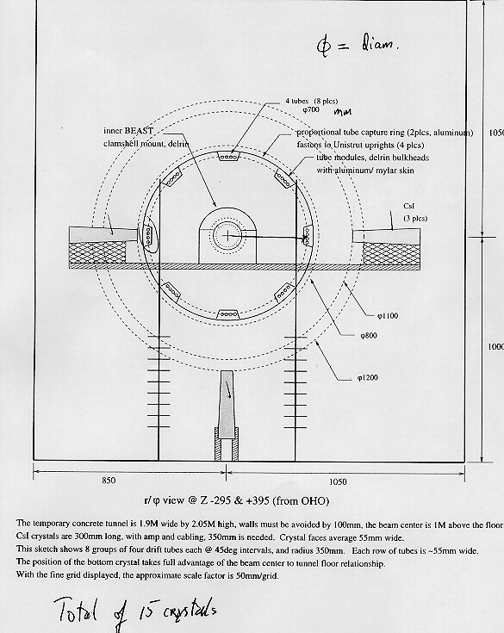
KEKB Commissioning in 1998
BEAST: Background Exorcism for a Stable BELLE Experiment
Non-magnetic support structure surrounding IP
No solenoid / Belle rolled out
Particle/Radiation monitoring
  Drift tubes (at r=7 and r=45 cm)
  PIN diodes
  MOSFETs
Belle Detector Elements
  CSI(Tl) Crystals
  Two Silicon Strip Ladders
Collaboration of KEK, Melbourne, Sydney, Hawaii, Cracow, BINP Novisibirsk, NTU
Micro TPC in green
(moveable in z)

Slide 14
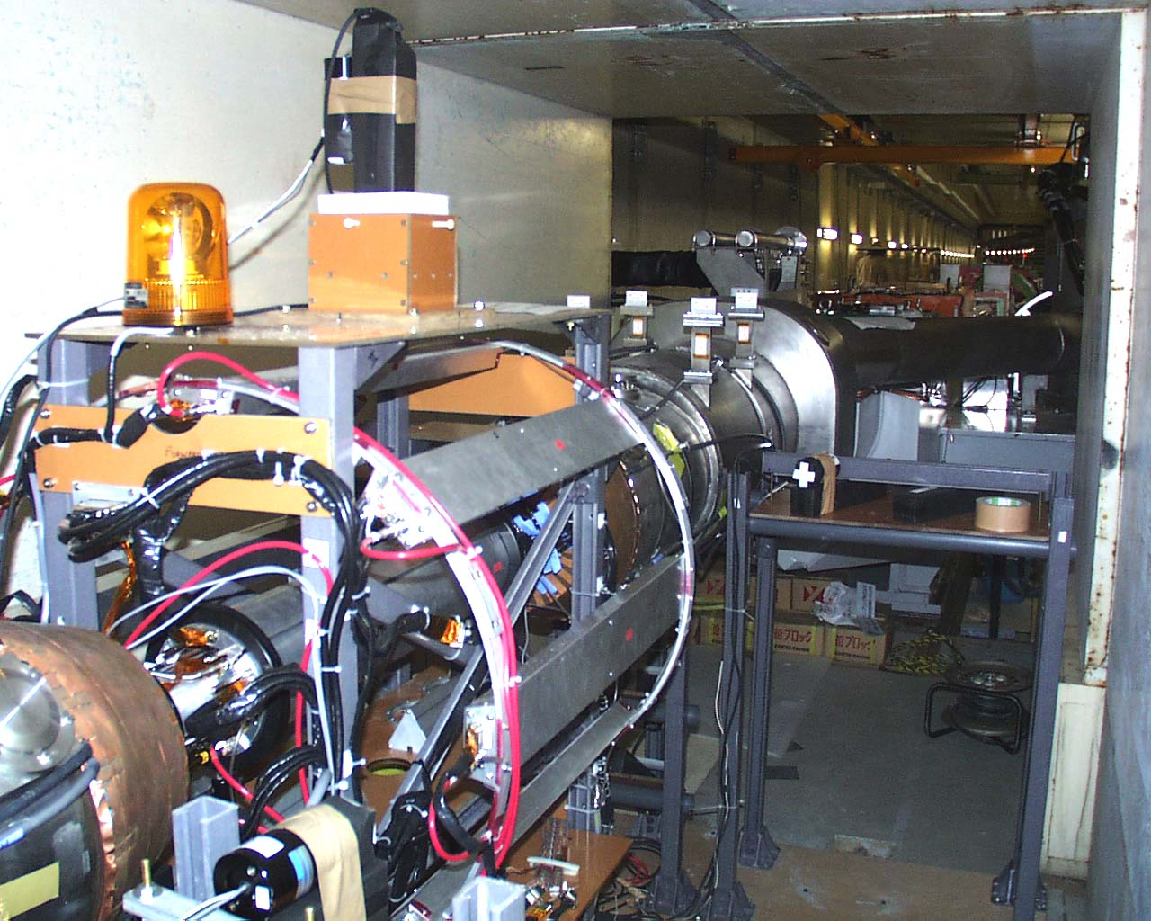
The BEAST in the Cave (Scenario C)
microTPC
microTPC

Slide 15
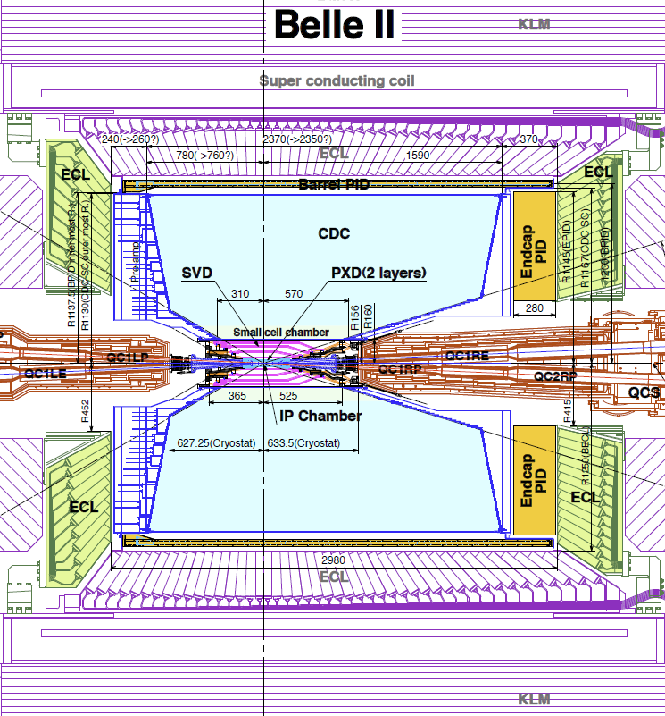
Scenario A
We roll-in the Belle solenoid + KLM and ECL without endcaps/TOP/CDC/SVD/PXD.
Similar to Scenario C
BEAST (minus barrel crystals) + pixel ladder(s) and microTPCs would fit
Solenoid field is a major bonus for accelerator commissioning and extrapolating BEAST measurements to Belle2
In this case, would want TPC drift field in z-direction (same direction as magnetic field)
This space for BEAST

Slide 16
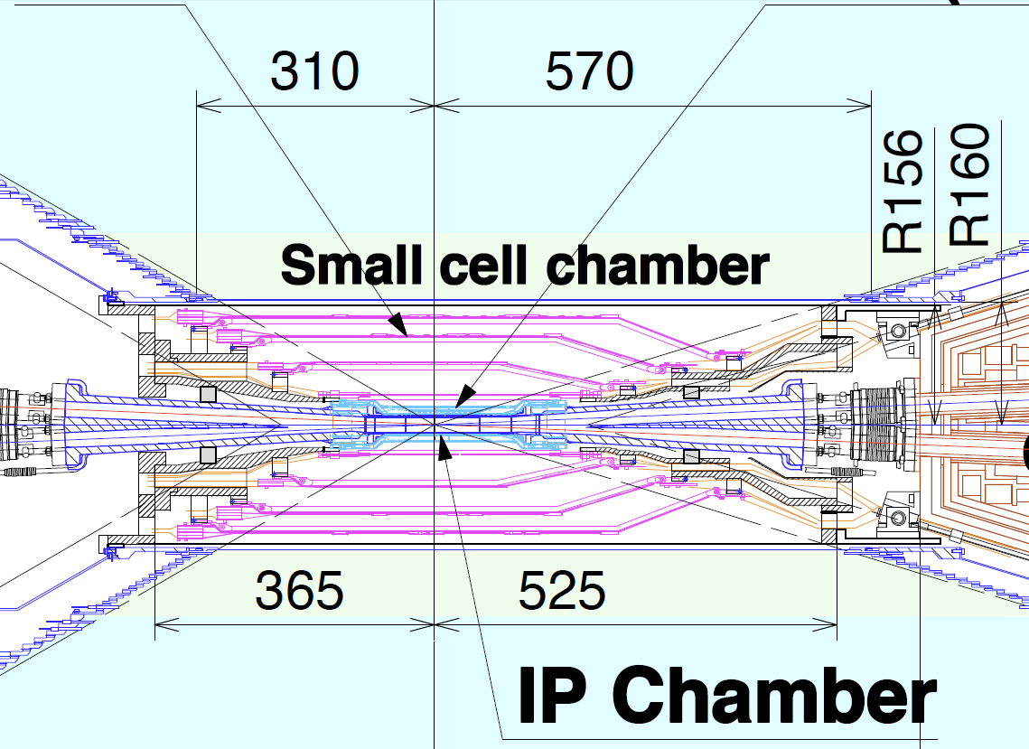
Scenario B
We roll-in the Belle solenoid with all the sub-detectors but SVD/PXD.
BEAST components should be installed in the space for SVD/PXD.
In this case Belle already provides tracking during commissioning.
Only install “MiniBeast”, consisting of diodes for radiation monitoring, a few SVD ladder(s), Pixel ladder(s)
TPCs not needed for tracking/pointing or for distinguishing photons and tracks.
Could install micro TPCs at small radius and run with high threshold, to only measure neutron recoils (blind to MIPs)
  Needs careful feasibility study
  Space for services is tight, but presumably doable

Slide 17
Comments / Discussion
If Belle Solenoid is present during commissioning (scenarios B,A), beam optics more similar to final Belle2 case
→ expect higher luminosity possible, commissioning measurements more representative of what to expect with final detector, commissioning measurements easier to translate to Belle2 background simulation
These benefits have to be weighed carefully against risk of damaging Belle2 sub-detectors during SuperKEKB commissioning , and against impact on schedule.
Related issue: Final focusing quadrupole magnets present during BEAST2 period? Seems that we only get full benefit of solenoid if these are in place.

Slide 18
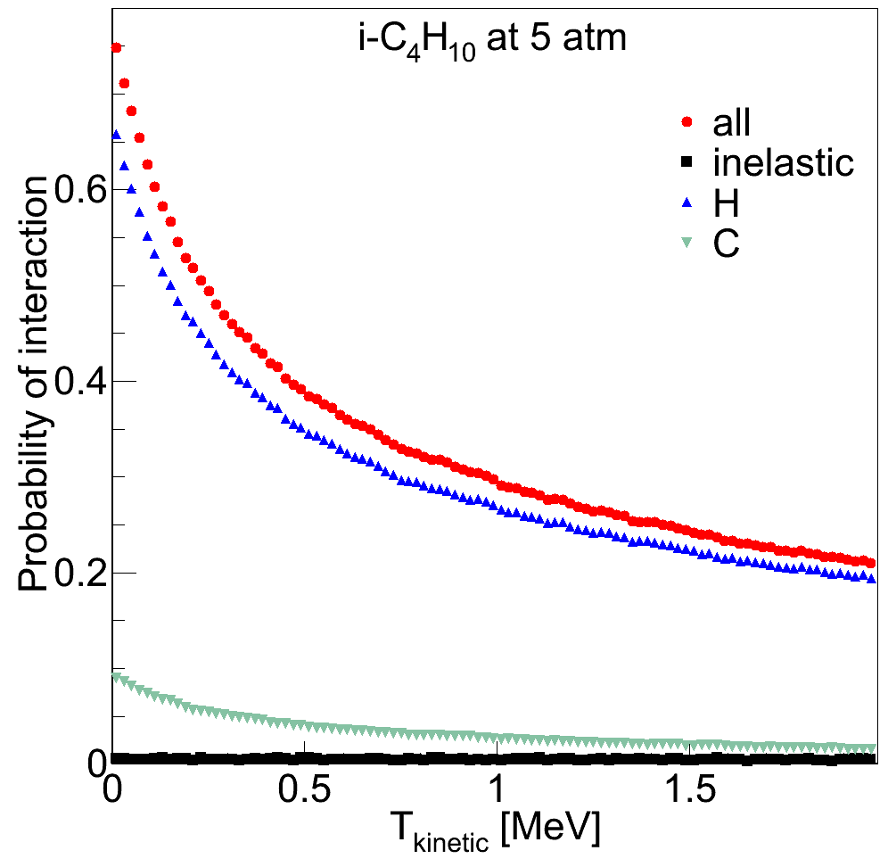
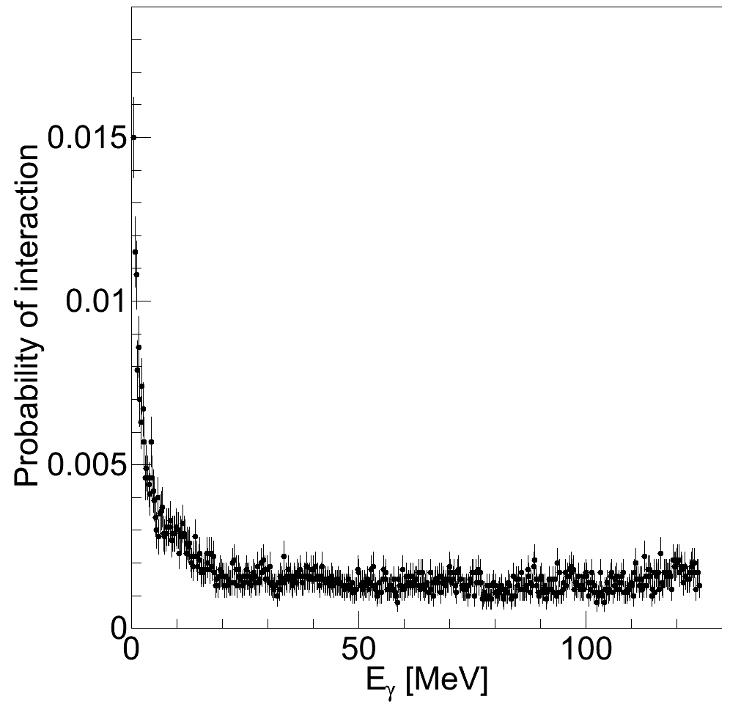
Plenty of Work
TPC scenarios need a lot more thought and input from Belle community
Also need to optimize TPC / BEAST / support structure geometries with simulation
  Postdoc working on GEANT TPC simulation (plots to right)
  Will interface this with Belle2 background simulation
Later on; construction, Installation, Operation, Analysis… plenty of work!
neutrons
photons
(Probabilities not properly normalized)

Slide 19
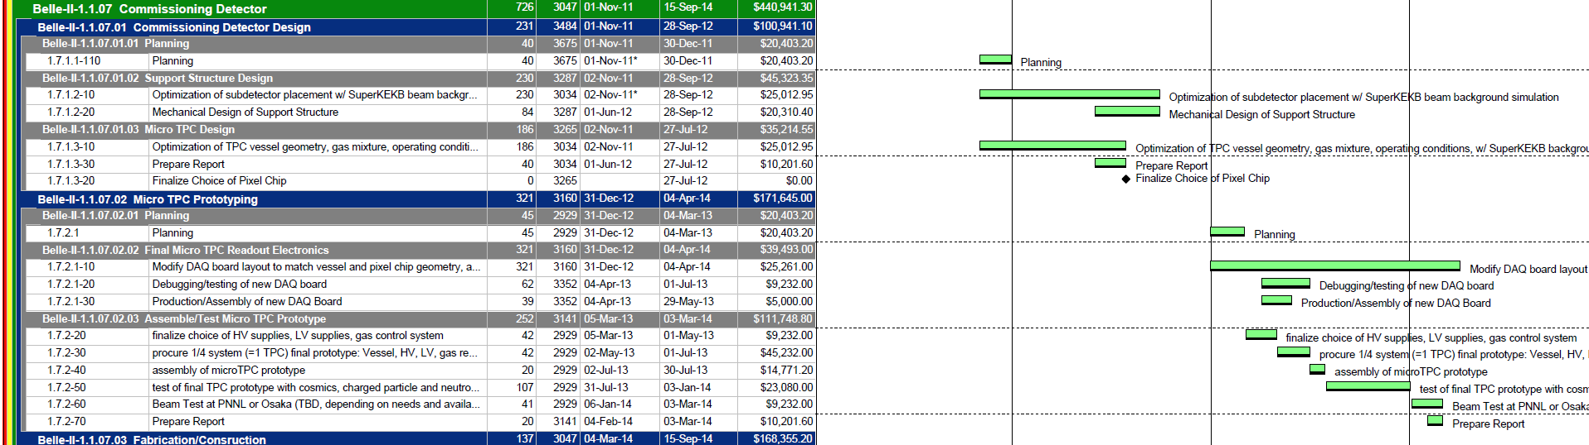
BEAST2 in DOE proposal
US Beast2 tasks were included in initial US Belle2 proposal to DOE
DOE not ecstatic, but “could be convinced to include BEAST in project”
Currently iterating US Belle2 WBS (below) in preparation for DOE CD1
B2GM in Nagoya, 7/7/11
19

Slide 20
Conclusion
Current Belle2 schedule may allow for up to 1 year of running with BEASTII, starting in 2014
Possible to study backgrounds in detail, which is important both for BG simulation and ensuring safe Belle2 roll-in
U. Hawaii proposing to contribute
  Support structure
  BEAST II mini-TPCs
Presented very rough ideas for three scenarios, surely needs a lot more thought and discussion
Should ramp up coordinated BEAST effort with involvement from different subdetector groups

